Slide 1
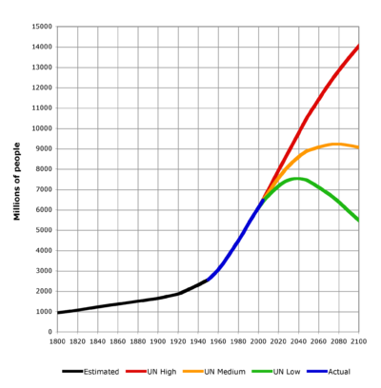
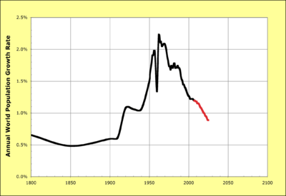
Population predictions
en.wikipedia.org

Slide 2
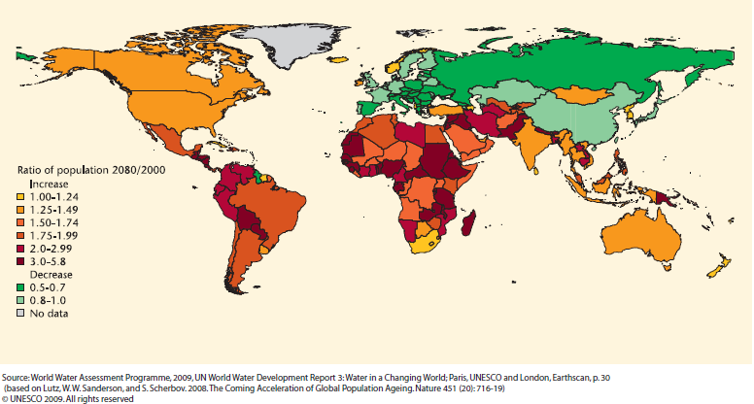
Population Projections

Slide 3
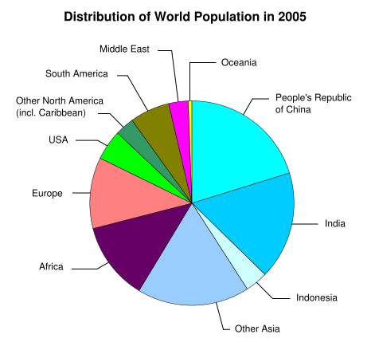
Population Distribution
www.eou.edu

Slide 4
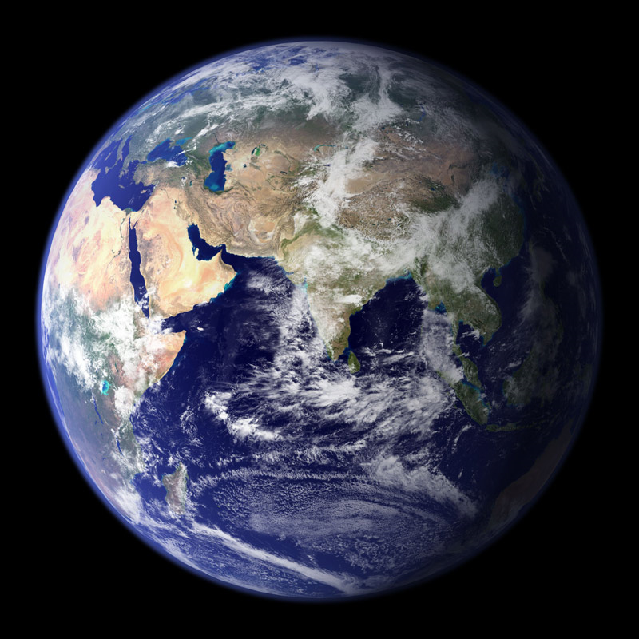
How Many is Too Many?
Jeroen, C., M. Van Den Bergh, P. Rietveld (2004) “Reconsidering the Limits to
World Population: Meta-analysis and Meta-prediction, BioScience, 54(3).
What is the World Carrying Capacity
100 Million People?
1 Billion?
10 Billion?
100 Billion?
Estimating World Carrying Capacity
Estimated many times since 1600’s
96 Estimates range from 1 to 10²¹ B!
50 from 1 to 10 B
33 from 10 to 80 B
13 > 80 B?
3 estimates over 10⁹ B, assumed
body heat can be removed (dissipated)
human food based on algae
all carbon on Earth is people or algae
Population
Life Style
Technology

Slide 5
Limiting Factors
Jeroen, C., M. Van Den Bergh, P. Rietveld (2004) “Reconsidering the Limits to
World Population: Meta-analysis and Meta-prediction, BioScience, 54(3).
90 estimates
Land / Food (71)
Water Availability (1)
Energy (3)
Carbon (4)
Heat Removal (1)
Primary Production (4)
Forest Products (1)
Nonrenewable Resources (3)
Multiple Factors (2)
Most limiting?
fresh water availability
forest products
nonrenewable products such as fertilizer
Waste Assimilation?

Slide 6
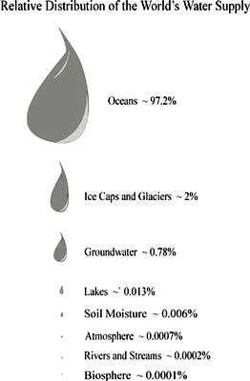
Population Limit - Water
Total Fresh Water
≅ 37.5 M km³
Drinking water needed per day
≅ 2 L/person/d
= 2.0E-12 km³/person/d
Maximum Population
www.umac.org

Slide 7
Why is 19E21 too many?

Slide 8
Population Limit - Water
www.globalchange.umich.edu
In 2006, 6 B people used ~ 30% of accessible renewable water
Accessible water not distributed well
South America: 5 % population & 26 % of runoff
Asia: 60 % population & 36 % of runoff
1 B don’t have good access to water
By 2025 could reach 70%
Notes:
We are using fossil water: ancient reserves of underground water: water in underground strata that has accumulated over millions of years and is therefore not a renewable resource, unlike other ground water
If it reaches 70 %, what about other species?

Slide 9
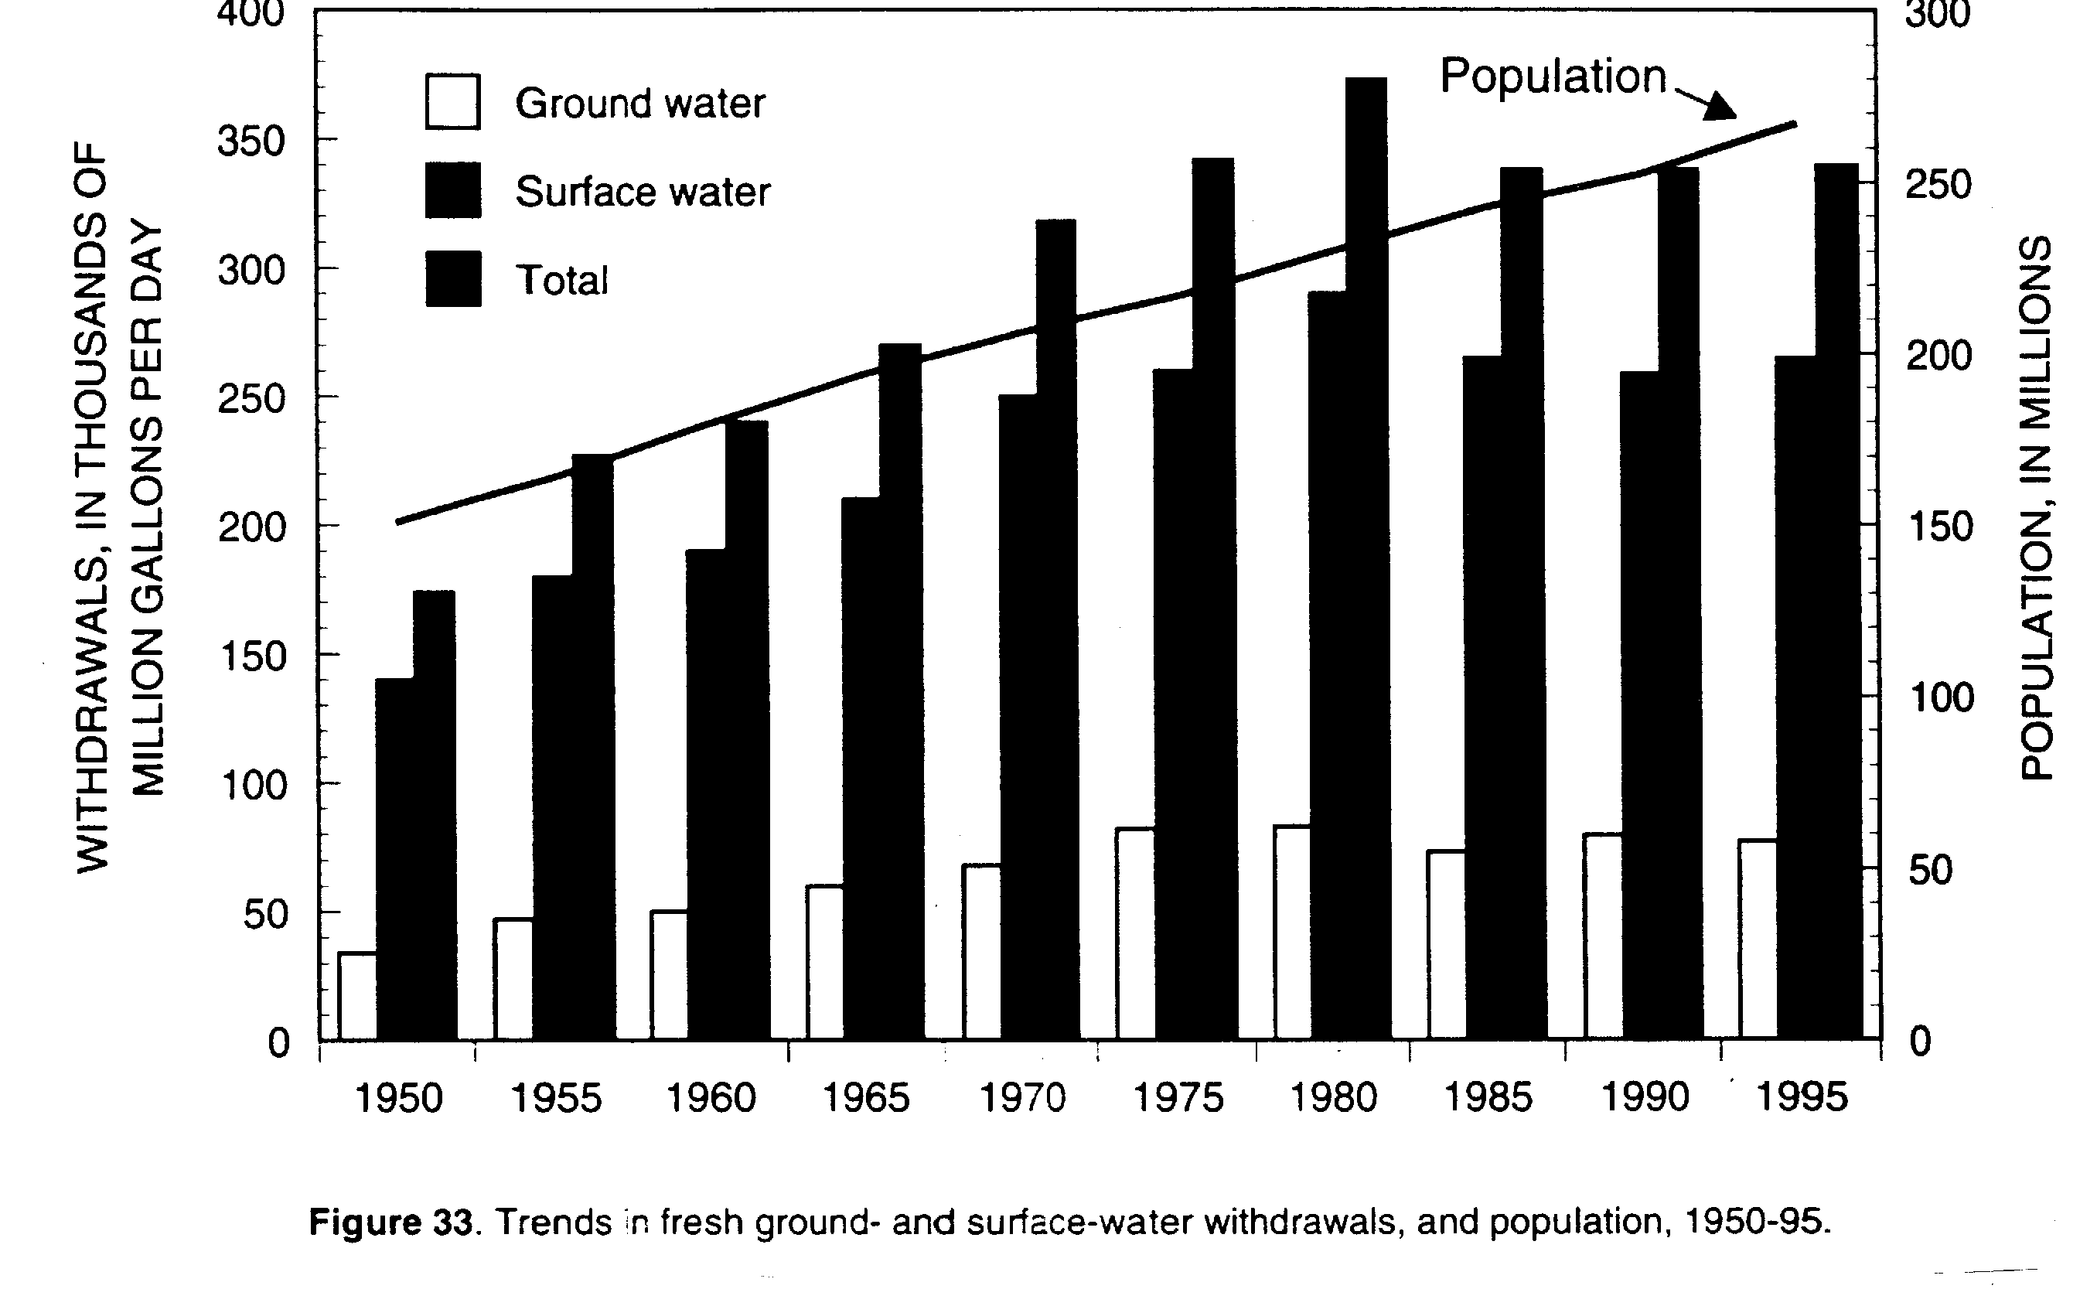
Good News - Water Withdrawals Decreasing

Slide 10
Population Limit - Land
Total Land Area
≅ 150 M km² (~30 %)
Standing Person Area
≅ 2 ft²/person = 1.858E-7 km²/person
Maximum Population
Notes:
Total Land Area
≅ 150 M km² (~30 %)
Standing Person Area
≅ 2 ft²/person = 1.858E-7 km²/person
Maximum Population
150,000,000 / 1.858E-7 = 807 T
T – tera – 10¹²
Why is this wrong?
It’s too low: multiple stories, below ground, ocean floor…

Slide 11
Why is 807 T wrong?

Slide 12
Population Limit – Agricultural Land
Thomas Robert Malthus (1766 –1834)
“An Essay on the Principle of Population”, 1798 – 1826
Assumed
Population can increase geometrically
Food Production can only increase arithmetically
Predicted that population would outstrip food supply in less than a century
What happened? – Technology!

Slide 13
Population Limit – Agricultural land
Shunji Murai, S. (1996) “Global environment and population carrying capacity”, The UNU global environmental Forum IV, Edited by Juha I. Uitto and Akiko Ono, The United Nations University, Tokyo, Japan.
Assumptions
Potential arable land - 21,375,000 km²
Potential agricultural productivity - 8,923E12 kcal/yr
World Carrying Capacity
7.34 B
At each country’s 1996 food consumption level
8.97 B
At world country-average
4.01 B
At North American consumption rate

Slide 14

Earth Energy & Mass Balance
Morton, SA., and M. Sharma, (2009) “Thermodynamic Considerations in Determining World Carrying Capacity,” ASEE Annual Conference, Arlington, TX
127,500 TW/yr available for plants
177,500 TW/year
Reflected: 50,000 TW/year
Atmosphere: 3.4E7 kg/yr
Space Dust: 1.5E8 kg/yr
Space dust accumulation: 66 cm over 4.5 B years

Slide 15
How much of the sun’s energy can we use?
Morton, SA., and M. Sharma, (2009) “Thermodynamic Considerations in Determining World Carrying Capacity,” ASEE Annual Conference, Arlington, TX
Photosynthesis
Plants use sun’s energy to grow
Primary Productivity
Net Primary Productivity
Plant products available for use by other entities
NNP ≅ 2.9E13 Kg/yr Carbon
Humans currently use ~ 41 % of NPP

Slide 16
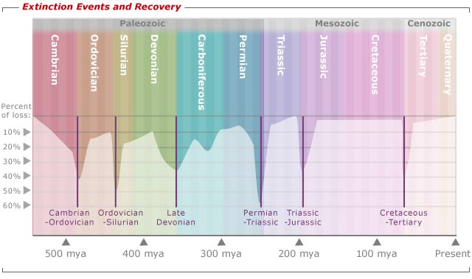
Homocene
5 major extinction events recorded in past
We appear to be in a 6th
Some are calling it the Homocene
Humans appear to be the cause
www.personal.psu.edu

Slide 17
Population Estimate - NPP
Morton, SA., and M. Sharma, (2009) “Thermodynamic Considerations in Determining World Carrying Capacity,” ASEE Annual Conference, Arlington, TX
Human population limit (HPL) function of?
How much Carbon humans need
~ 1200 kg per capita Carbon
Fraction NPP we allocate for ourselves, H_{NPP}
HPL = H_{NPP} x 2.9E13 /1200
= H_{NPP} x 24,200,000,000
If H_{NPP} should be 10 %
HPL =
If H_{NPP} should be 41 % and we use 1200 kg
HPL =

Slide 18
Population - Conclusion
World Carrying Capacity
Between 2 and 10 B?
Higher numbers requires changes in

